Slide 1
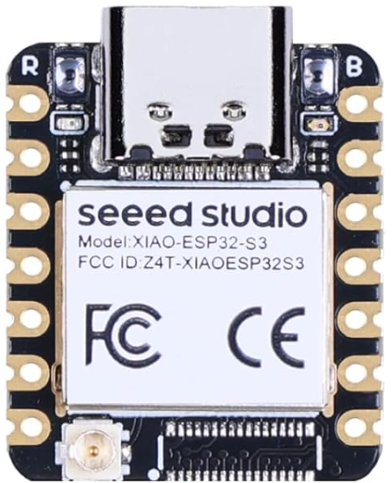
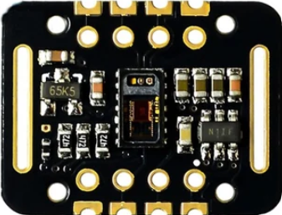
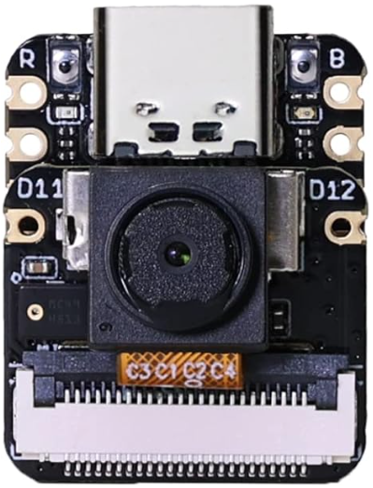
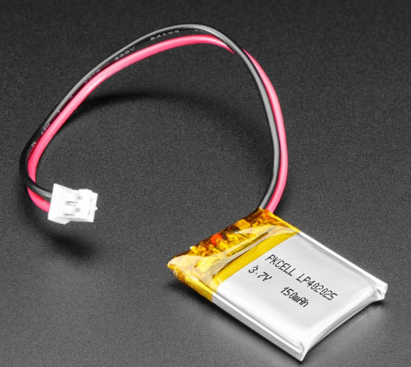
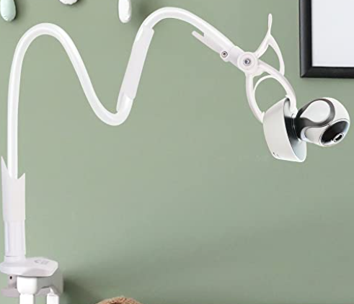
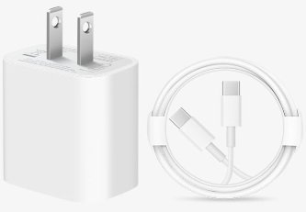
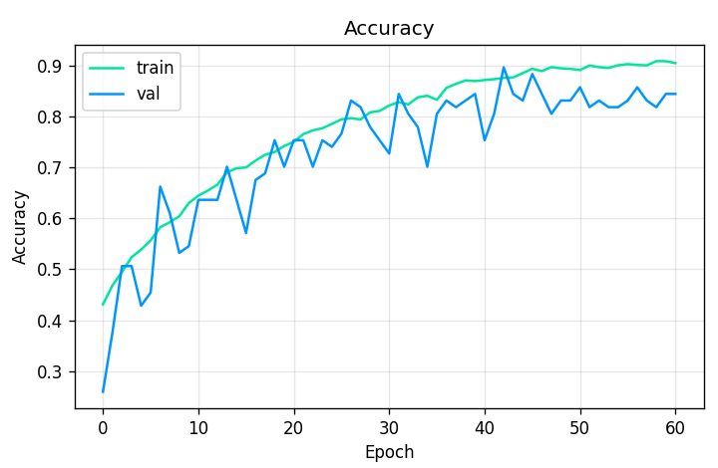
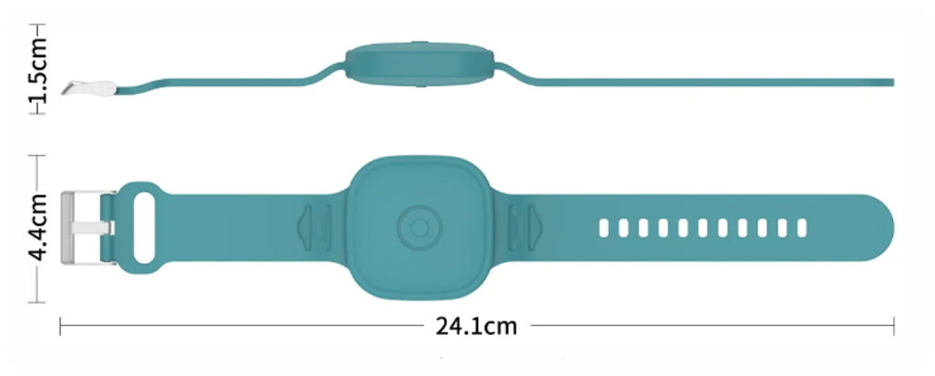
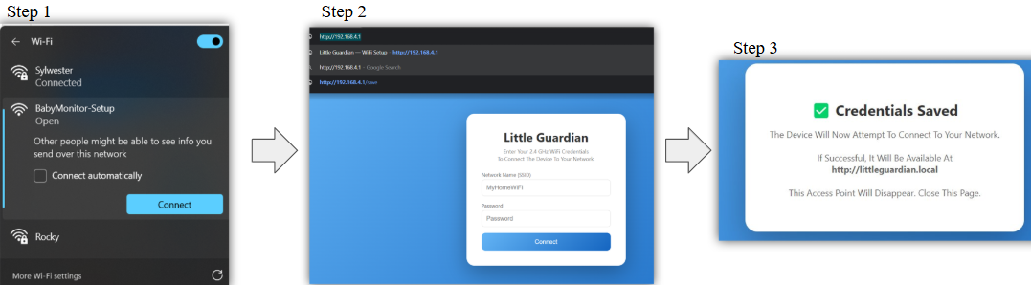
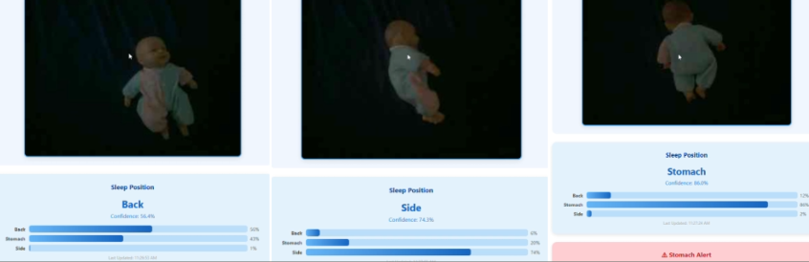
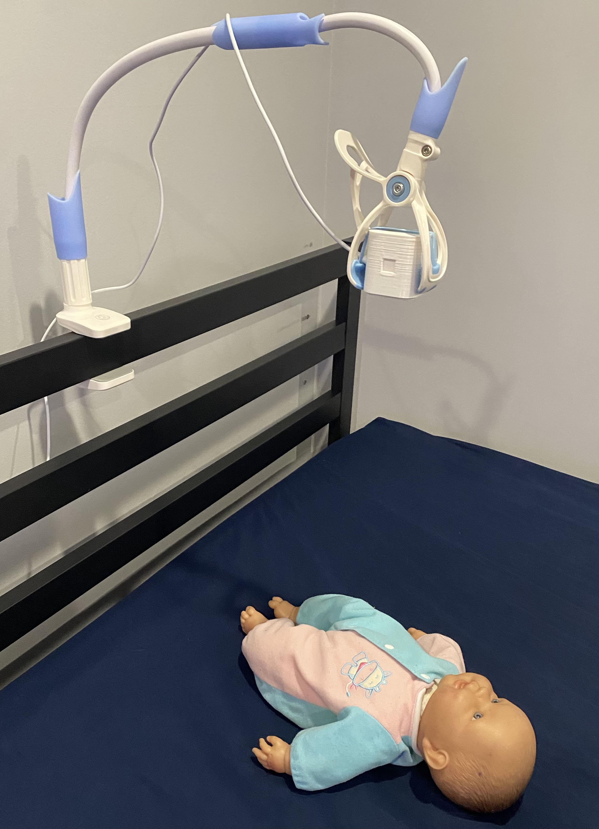
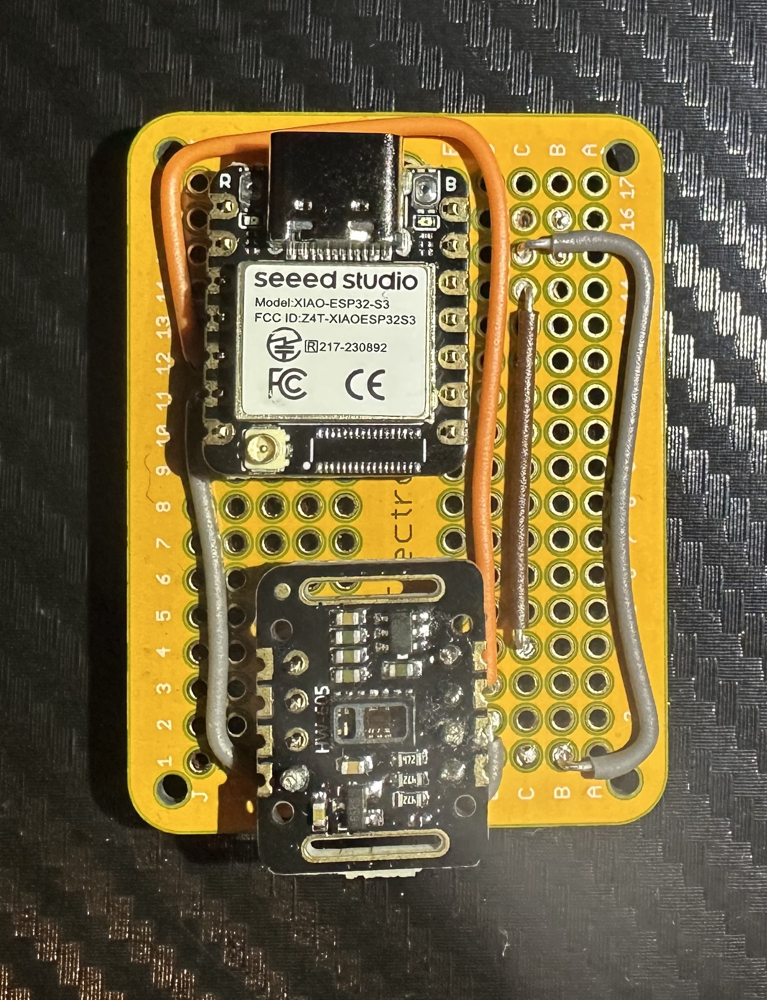
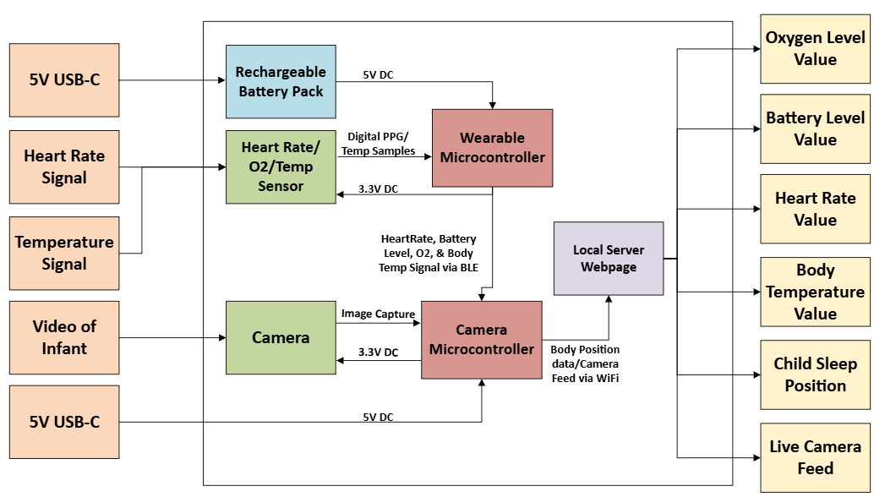
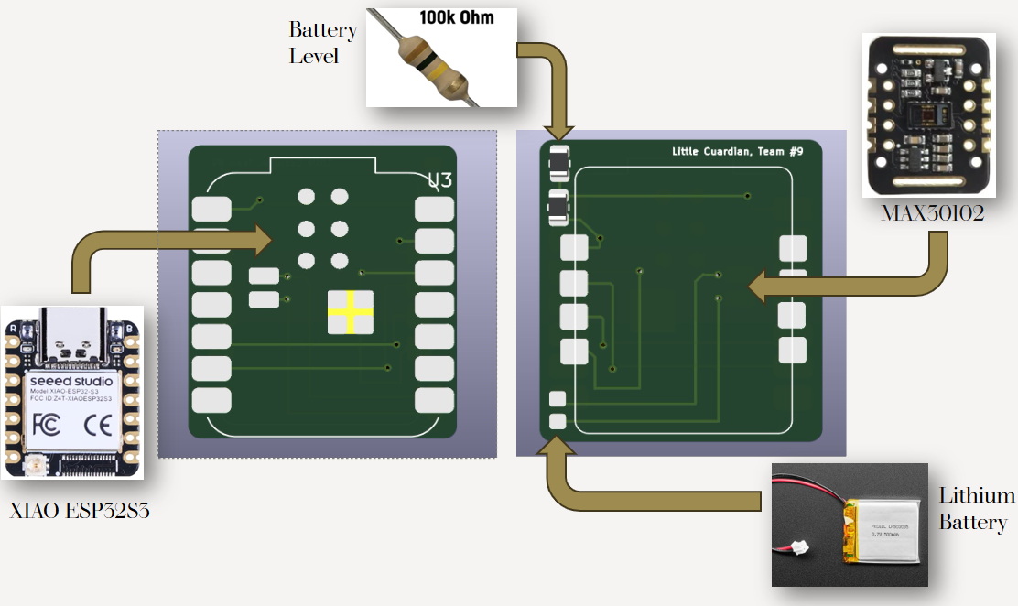
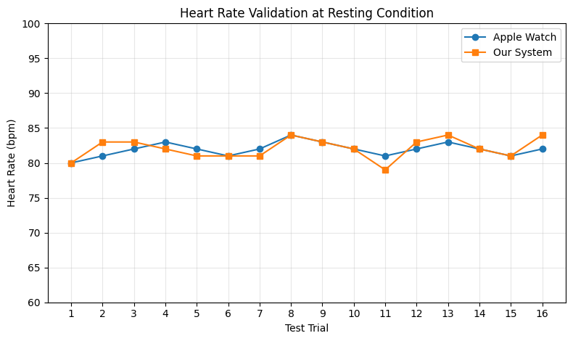
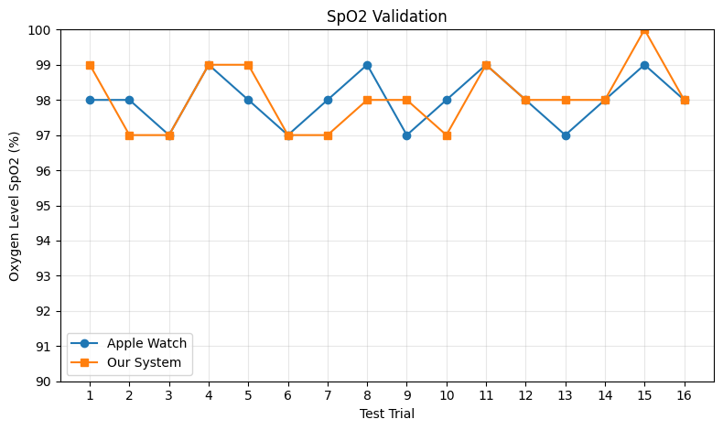
Little Guardian
Team 9
Dominik Kornak, Julian Pelayo, Anthonio Torres, Alfonso Naula, Zhixian Yin
Advisor : Zhao Zhang
Abstract
Materials
Results
Engineering Requirements
In the United States, about 3,000 infants die from SIDS a year. SIDS, or sudden infant death syndrome, is an occurrence where an infant unexpectedly dies while sleeping. There is no single known cause of SIDS; instead, it may result from multiple factors such as asphyxiation, sudden cessation of breathing, or overheating. Because these events often occur without warning, monitoring infant health and sleeping conditions can help caregivers identify potential risks and mitigate them. As a means toward addressing this issue, our team developed a device that monitors and displays the health biometrics of an infant along with the infant’s sleeping position in real time. Our system integrates various microcontrollers, sensors, a camera, and machine learning algorithms to collect and analyze real-time data. Sensors are used to track infant vitals, while the camera and on-device machine learning components help detect and classify the infant’s sleeping position. This information is then displayed on a local Wi-Fi webpage for convenient monitoring. Current child monitoring devices are often expensive, while affordable options provide limited functionality. This product aims to address these limitations by providing an accurate, safe, and cost-efficient monitoring solution with sufficient battery life to operate throughout the night, meeting the practical needs of caregivers.
-Seeed Studio XIAO-ESP32S3
-MAX30102 Sensor
-OV3660 Camera Sensor
For our Machine Learning model, we achieve an 89.5% validation accuracy. We achieve this by creating a dataset with 5 different doll images taken at different lightings and positions. This accuracy varies slightly to our real-world implementation; however, it still correctly depicts the correct sleeping position for all positions, when the camera is positioned about 16 inches above the baby in a top-down view.
1 | The wearable device will be encased in food grade silicon
2 | The camera must detect if the infant is laying on their back, side or belly with an accuracy of 80% using the system setup details provided in the manual
3 | The device must auto shutoff when skin temperature reaches a temperature of 108F
4 | The total production cost of the device must be below $120
5 | The wireless connection with the modules should have at least 200 feet of range in an open space environment (no walls/obstacles)
6 | The device should have a battery life of at least 12 hours
Other Material:
-Waterproof Air tag Bracelet
-10 Foot USB-C Charging Cable
-Crib Camera Mount
-Lithium Polymer Battery
-Custom PCB
Production Cost: $80.21
Methodology
Conclusion
To connect the system to your local Wi-Fi, it’s a simple three step process. When the camera is powered on, it hosts a Wi-Fi network named BabyMonitor-Setup, once you connect to it, you enter its IP address as the URL (192.168.4.1) which then loads a page and prompts you to enter your local Wi-Fi credentials. Once entered, reconnecting your device to the local Wi-Fi and visiting (http://littleguardian.local) gives you access to the local webpage where you can monitor your infant.
Overall, we believe the prototype we built this semester is a promising start to a safe sleep alternative. Although there is room for improvement in some of our readings, having a machine learning accuracy well above our engineering requirements shows what we can accomplish with limited time and resources. This device can help bring peace of mind to a parent as their child sleeps.
The entire sleep position inference is performed on-edge, with the machine learning algorithm running directly on the ESP32-S3. The algorithm correctly detects and classifies all three sets of images as shown below. When the Stomach class confidence exceeds 70%, the webpage alarms the user with a popup while also triggering an alarm sound. This 70% confidence threshold was set so the number of false alarms is mitigated.
Overview
In the future, we plan to add:
Battery Charging Module
Higher Accuracy Health Biometrics Sensor
Fully Integrated Mobile Application
Access To Data Away From Home
Our two-system design serves two purposes: first, a camera detects the infant’s sleeping position and provides a live video feed to the user; second, a wearable band on the infant’s ankle monitors heart rate, oxygen level, and skin temperature. Our 3 other preliminary designs implemented separate heartrate and temperature sensors, implemented a separate heart rate and O2 sensor, and replaced the camera module with a gyroscope system for infant positioning. We decide to choose the single combined sensor configuration because of the size and implementation ability; also, it was most cost effective.
The PCB measures 23.4 mm × 20.5 mm and is designed as a two-layer board. The front layer is dedicated to the ESP32-S3, while the back layer accommodates the MAX30102 and the lithium battery. Since the ESP32-S3 does not include a dedicated GPIO pin for direct battery level measurement, a voltage divider circuit using 100kΩ resistors was implemented. This allows the battery voltage to be scaled appropriately and monitored through an available GPIO pin.
Our system’s heart rate and oxygen saturation measurements were validated against Apple Watch data. With valid readings, the mean absolute error was 1.00 bpm for heart rate and 0.44% for SpO₂, demonstrating reasonable accuracy.
The accuracy of body temperature readings were found by taking body temperature samples with our system and a digital thermometer simultaneously. These readings were taken on the same area of the leg and in the same conditions. The percent error at each point was calculated and the mean absolute percentage error was found to be 0.96% leading to an overall accuracy of 99.04%.
This two-system design is shown above where each system has a separate microcontroller, meaning each as a separate power source. The wearable device is powered by a rechargeable lithium-ion battery, and the camera is plugged in to a power source via a 5V USB-C. The wearable sends data to the camera via a Bluetooth connection where the wearable acts as the server and camera as client, and then the Camera connects to a local Wi-Fi network which then displays a webpage for the user to monitor. The webpage consists of the vital readings and battery level of the wearable, and the live feed and sleep position of the camera.
We also implement a temperature shutoff on the wearable for infant safety. If the ESP32 microcontroller detects a temperature exceeding 42 °C, the system automatically shuts off to prevent discomfort or injury. However, at normal operation, the temperature sits around 30 °C, well below the maximum threshold. This is a safety feature we tested using a heat gun.
Acknowledgements
Faculty Advisor: Zhao Zhang
Industry Advisor: Syeda Afifa Nadeem
Professor: Mathew Paul Alonso
TA: Deepika Aggrawal
UIC Makerspace
UIC Senior Design Lab Staff

